Slide 1
Data Protection
Ji-Beom KIM

Slide 2
Outline
Weekly report
Summary of this week’s work
Your work
Conclusion
Your opinion/thought
Action item

Slide 3
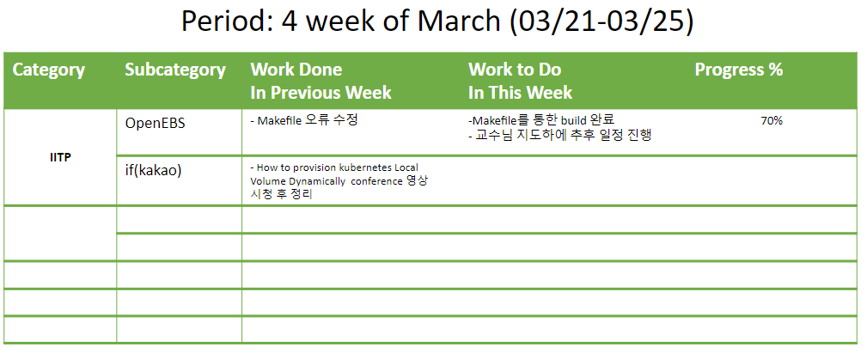
Weekly report

Slide 4
Summary of work this week
Completed Cstor-operators build
Under the guidance of the professor, I will proceed with the schedule later.(detailed data structure analysis or function call sequence implementation)

Slide 5



Your work(install)
Os : centOS 7
k8s : v1.23.4
Golang : 1.13 -> 1.13.15

Slide 6
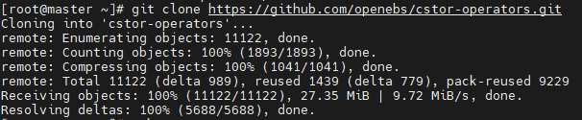

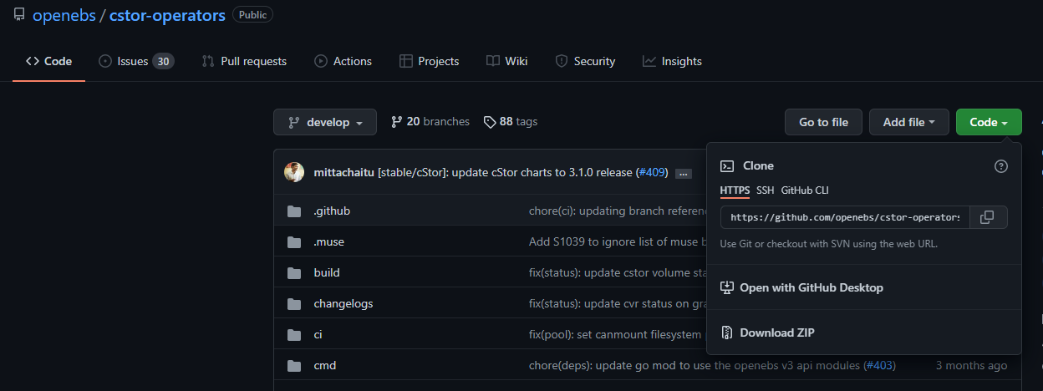
Your work(git clone)
Clones a repository(cstor-operators) into a newly created directory.

Slide 7

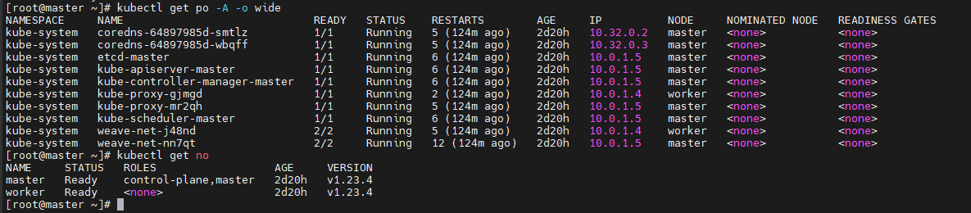
Your work(make)
Make The command works, There was no error.

Slide 8
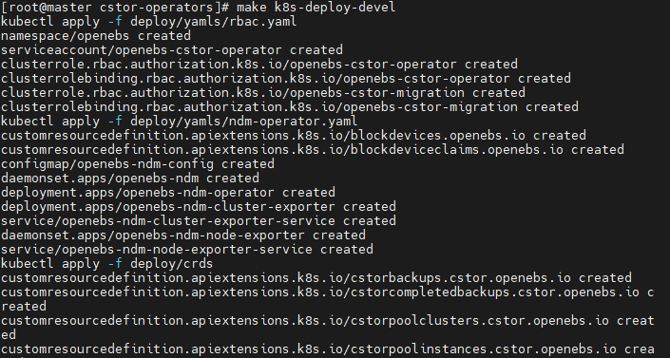
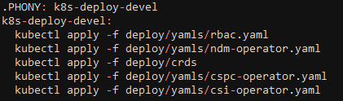
Your work(.PHONY)
The phony target is not the name of the actual file, but the target. There are two purposes for using the pony target.
1) To prevent conflicts with files of the same name
2) To improve performance
Command for run Phony target
$ make (Phony target name)
Phony target in Makefile

Slide 9
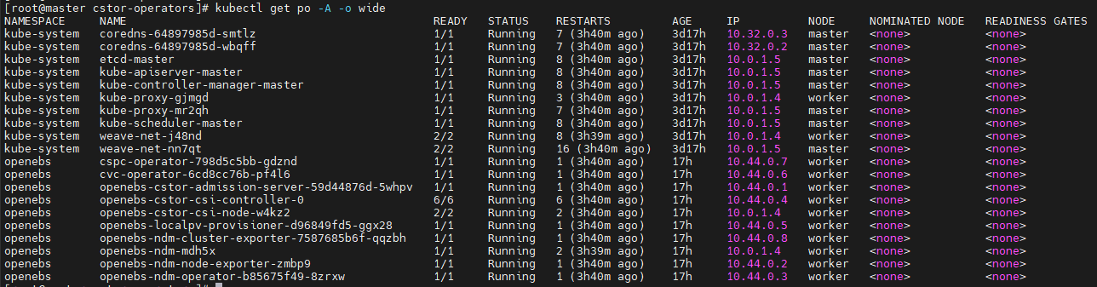
Your work(.PHONY)
The phony target is not the name of the actual file, but the target. There are two purposes for using the phony target.
1) To prevent conflicts with files of the same name
2) To improve performance
Check the pod goes up

Slide 10
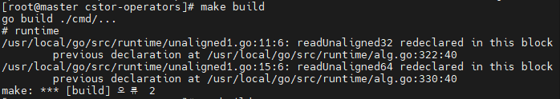
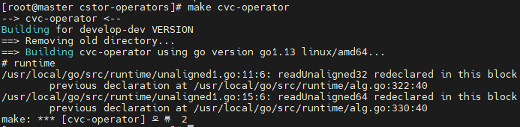
Your work(error)
However, errors occurred in other phony targets.
Error that a function with the same name was used.

Slide 11
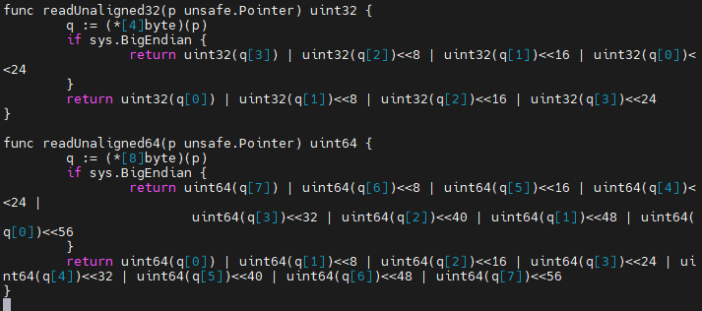
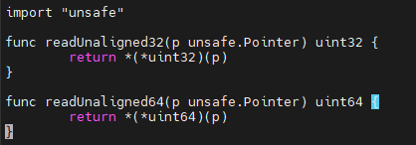
Your work(error)
However, errors occurred in other phony targets.
I tested the file to alternately annotate the functions, but another error occurred.
unaligned1.go
alg.go

Slide 12
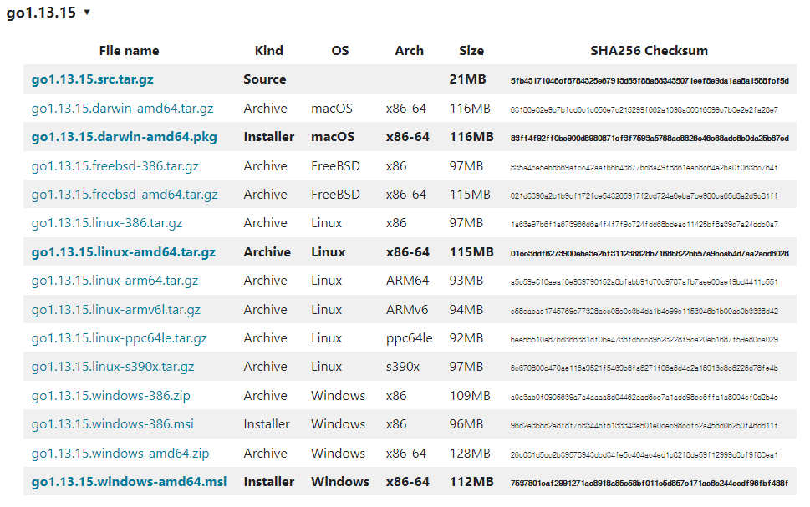
Your work(go version)
GoLang reinstall the latest version of 1.13.15 from 1.13

Slide 13

Your work(go version)
GOROOT is usually located in ‘/usr/local/go’ on mac and linux, but when Go is installed, Go-related executables and SDKs are located.

Slide 14
Your work(go version)
GOPATH is where packages, libraries, and sources received through the go get command from the command line are located.
GOPATH basically has bin, pkg, and src folders.

Slide 15

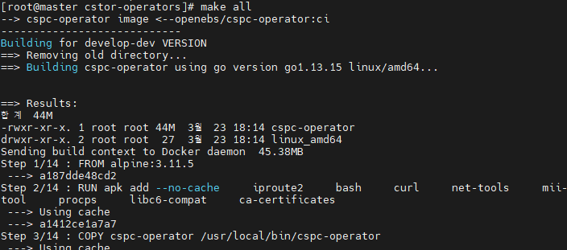
Your work(go version)
Build all the phony targets in the phony target "all" with the "make all” command

Slide 16
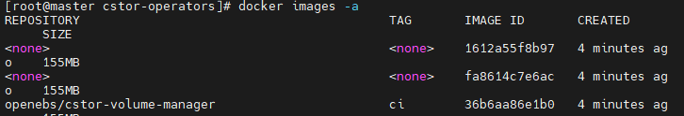
Your work(go version)
Confirm that the docker image is properly built

Slide 17
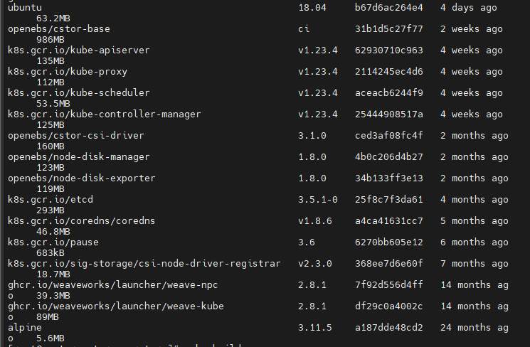
Your work(go version)
Confirm that the docker image is properly built

Slide 18
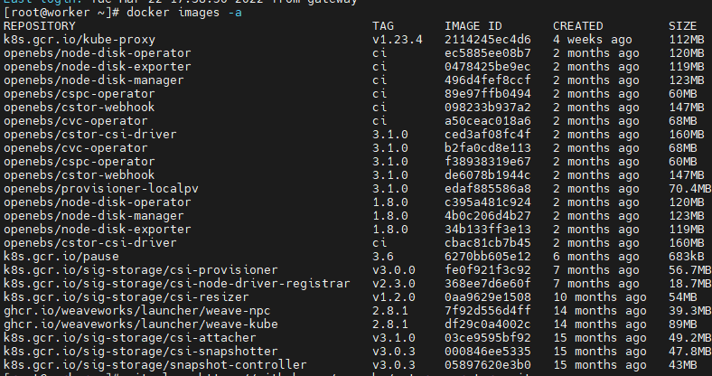
Your work(go version)
Check on worker node as well

Slide 19
Your work(go version)
Create a pod - the built docker image

Slide 20
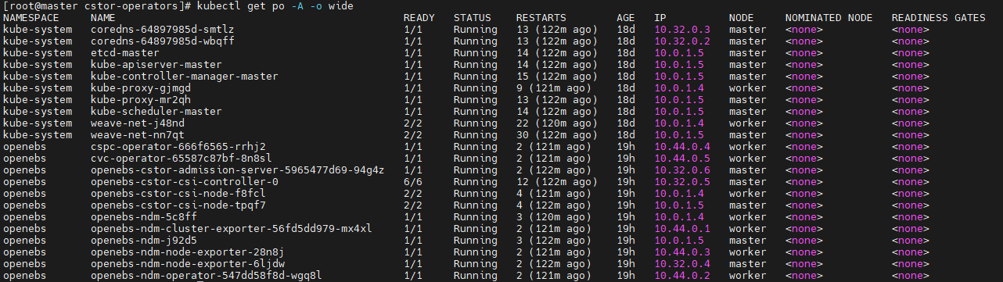
Your work(go version)
Check the pod goes up

Slide 21
Conclusion
I solved the error. Docker image can now be built through 'makefile‘.
be implementable for function call order

Slide 22
Your opinion/thought
I think it would be better to select a function of the file that you currently need and test it with logs.

Slide 23
Action items
Under the guidance of the professor, I will proceed with the schedule later.(detailed data structure analysis or function call sequence implementation)

